Slide 1

CSA-0615 Design and analysis of algorithms
Title:
Analyze and Compare Growth Functions Using Mathematical Techniques
and Asymptotic Concepts with Graphical and Visual Interpretation
Faculty Name: Dr.Nagarajan Govindasami
Name: Ch.Akhil
Reg no:192525250

Slide 2


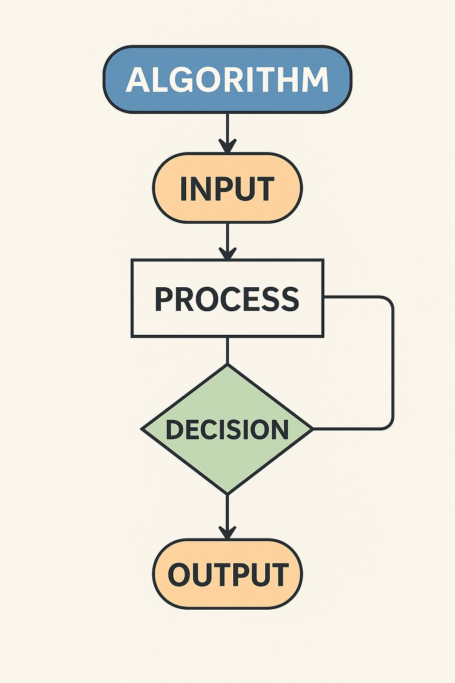
Introduction
Growth functions describe how an algorithm's execution time or memory usage increases as the input size (n) grows. They help evaluate algorithm efficiency and scalability. In AI and Expert Systems, analyzing growth functions is essential for selecting algorithms that provide faster execution and optimal resource utilization.
Key Points:
Measures algorithm performance.
Helps compare different algorithms.
Supports efficient AI system design.
Improves scalability for large datasets.

Slide 3
Objectives & Problem Statement
Objectives
Understand the concept of growth functions.
Compare algorithms using asymptotic notations.
Analyze performance with mathematical techniques.
Interpret results using graphs and tables.
Problem Statement
AI and Expert Systems often process large amounts of data. Choosing an inefficient algorithm can increase execution time and memory usage. Growth function analysis helps identify algorithms that perform efficiently and scale well as the input size increases.

Slide 4
Growth Functions & Asymptotic Analysis
Time Complexity | Common Example
O(1) | Hash Table Lookup
O(log n) | Binary Search
O(n) | Linear Search
O(n log n) | Merge Sort
O(n²) | Bubble Sort
Asymptotic Notations: O(n) – Worst Case Ω(n) – Best Case Θ(n) – Average Case Lower complexity = Better performance

Slide 5
Comparitive analysis
Algorithm comparision
Algorithm | Complexity | Performance
Binary Search | O(log n) | Excellent
Linear Search | O(n) | Good
Merge Sort | O(n log n) | Very Good
Bubble Sort | O(n²) | Poor
Interpretation: Lower complexity algorithms require fewer operations and are more suitable for AI applications.

Slide 6
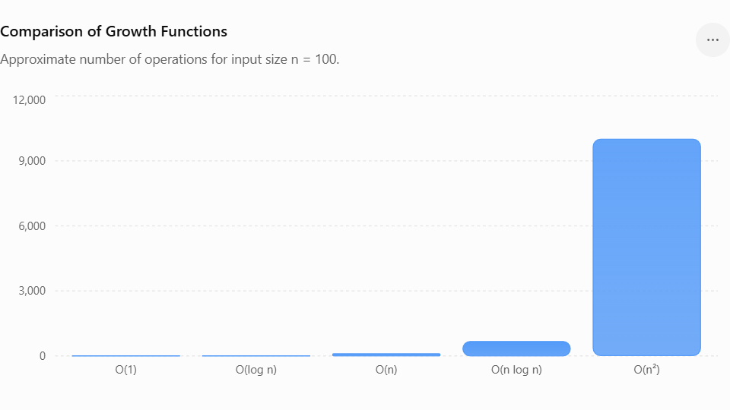

Slide 7

Applications in AI & Expert System
Applications:
Growth function analysis helps improve the performance of intelligent systems by selecting efficient algorithms.
Knowledge base searching
Rule-based expert systems
Machine learning data processing
Robotics and path planning
Game AI and decision-making

Slide 8
Conclusion
Growth functions provide a mathematical way to analyze algorithm performance. Asymptotic notations help compare algorithms based on their efficiency and scalability. Graphs and tables make these comparisons easier to understand. Choosing algorithms with lower growth rates enables AI and Expert Systems to achieve faster execution, better resource utilization, and improved overall performance.
THANK YOU

